Slide 1
Sentiment Analysis Of Incoming Calls On Helpdesk
PIP4004 University Project-II
Review-1
Batch Number:COM23
Roll Number | Student Name
20211COM0006 | DISHIK L SETTY
20211COM0075 | DEEPIKA C S
20211CEI0055 | PRAKASH SINGH
20211COM0029 | PAAVANA GOWDA
Under the Supervision of,
Ms. IMPA B H
Assistant Professor
School of Computer Science and Engineering
Presidency University
Name of the Program: Computer Engineering
Name of the HoD: Dr.Gopal Krishna Shyam
Name of the Program Project Coordinator: Dr.Sudha P
Name of the School Project Coordinators: Mr. Md Ziaur Rahman

Slide 2
Introduction
• Helpdesks receive thousands of calls daily, covering complaints, inquiries, and feedback. • Customer sentiment plays a crucial role in evaluating service quality. • Manual call monitoring is inefficient and prone to human bias. • Machine Learning (ML) and Natural Language Processing (NLP) automate sentiment detection. • Sentiment analysis classifies calls into positive, negative, or neutral categories. • Helps in identifying recurring issues and improving response strategies. • Fake or fraudulent calls can also be detected through sentiment patterns. • AI-based systems provide real-time analytics for better decision-making. • The study proposes a model integrating NLP, supervised learning, and deep learning. • Goal: Improve customer satisfaction and helpdesk efficiency.

Slide 3
Literature Review
Author(s) | Title | Description | Limitations
Smith et al. (2017) | Support Vector Machines for Sentiment Analysis | Used SVM for classifying call sentiments based on TF-IDF and Bag-of-Words techniques. | Struggles with complex sentence structures and sarcasm.
Johnson (2018) | Recurrent Neural Networks for Emotion Detection | Implemented RNN for sentiment classification, using Word2Vec embeddings. | High computational cost; performance degrades with longer sentences.
Chen et al. (2019) | CNN-based Sentiment Classification of Call Transcripts | Applied CNN for sentiment analysis, leveraging n-gram embeddings. | CNN models lack contextual understanding of sequential data.
Kim et al. (2020) | BERT-based Sentiment Analysis for Helpdesk Calls | Used BERT’s transformer-based architecture to capture contextual meanings. | Requires a large dataset for effective training and fine-tuning.

Slide 4
Literature Review conti
Author(s) | Title | Description | Limitations
Zhang & Li (2021) | Naïve Bayes for Sentiment Analysis in Call Centers | A probabilistic model using TF-IDF and PoS tagging for sentiment classification. | Struggles with nuanced emotions and polysemy.
Patel et al. (2022) | Hybrid Approach to Fake Call Detection using NLP and ML | Hybrid Approach to Fake Call Detection using NLP and ML | Hybrid Approach to Fake Call Detection using NLP and ML
Kokane et al. (2022) | Word Sense Disambiguation for Sentiment Analysis | Word Sense Disambiguation for Sentiment Analysis | Word Sense Disambiguation for Sentiment Analysis
Gupta & Sharma (2023) | Deep Learning for Multilingual Sentiment Analysis | Deep Learning for Multilingual Sentiment Analysis | Deep Learning for Multilingual Sentiment Analysis

Slide 5
Proposed Method
Data Preprocessing
• Speech-to-text conversion for audio calls. • Removal of noise, filler words, and redundant text. • Tokenization, stemming, and lemmatization for text analysis.
2. Feature Extraction
• Word embedding techniques: Word2Vec, GloVe, and TF-IDF. • Sentiment lexicons: WordNet, OMSTI, SemCor for word meaning mapping.
3. Sentiment Classification
• Supervised Learning: SVM, Naïve Bayes, Decision Trees. • Deep Learning: CNN, LSTM, and Transformer models. • Hybrid Models: Combining rule-based and ML approaches.
4. Model Training & Evaluation
• Training using labelled datasets with customer feedback history. • Performance metrics: Accuracy, Precision, Recall, F1-score.
5. Real-time Deployment & Dashboard
• Sentiment visualization using dashboards for helpdesk teams. • CRM integration for dynamic response adjustments.
6. Fake Call Detection & Anomaly Tracking
• Identifies unusual speech patterns and sentiment shifts. • Prevents scams, fraud, and misinformation in helpdesk calls.

Slide 6
Objectives
Automate Sentiment Detection: Reduce manual effort in call monitoring. • Improve Customer Satisfaction: Address complaints based on sentiment trends. • Enhance Service Efficiency: Quick identification of urgent customer concerns. • Real-time Analysis: Provide live feedback on customer interactions. • Reduce Fake Calls: Detect fraudulent or spam calls using AI models. • Optimize Decision-Making: Use sentiment insights for service improvements. • Support Multilingual Processing: Extend AI support across different languages. • Ensure Secure Transactions: Identify scam patterns in helpdesk calls. • Enhance Response Strategies: Develop adaptive customer interaction approaches. • Scalability for Future Expansion: Implement NLP models for chat and email support.

Slide 7
Methodology
1. Data Preprocessing
• Speech-to-text conversion for audio calls. • Removal of noise, filler words, and redundant text. • Tokenization, stemming, and lemmatization for text analysis.
2. Feature Extraction
• Word embedding techniques: Word2Vec, GloVe, and TF-IDF. • Sentiment lexicons: WordNet, OMSTI, SemCor for word meaning mapping.
3. Sentiment Classification
• Supervised Learning: SVM, Naïve Bayes, Decision Trees. • Deep Learning: CNN, LSTM, and Transformer models. • Hybrid Models: Combining rule-based and ML approaches.
4. Model Training & Evaluation
• Training using labeled datasets with customer feedback history. • Performance metrics: Accuracy, Precision, Recall, F1-score.
5. Real-time Deployment & Dashboard
• Sentiment visualization using dashboards for helpdesk teams. • CRM integration for dynamic response adjustments.
6. Fake Call Detection & Anomaly Tracking
• Identifies unusual speech patterns and sentiment shifts. • Prevents scams, fraud, and misinformation in helpdesk calls.

Slide 8
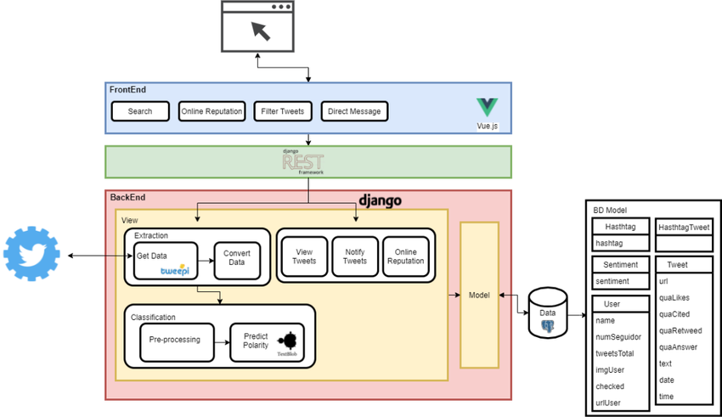
Methodology

Slide 9
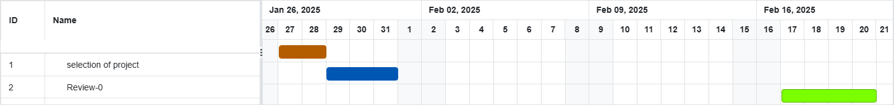
Timeline of Project

Slide 10
Expected Outcomes
Automated Sentiment Analysis: Faster and more accurate call classification.
Enhanced Service Quality: AI-driven analysis improves customer interactions.
Fraud Detection: Identifies scam or spam calls effectively.
Data-Driven Decision Making: Helps businesses refine their customer support.
Cost & Time Savings: Reduces manual call analysis efforts.
Scalability & Multilingual Support: Expands AI capabilities for global applications.
Adaptive Learning: AI models continuously improve with new call data.
CRM Integration: Improves personalized responses based on historical data.
Future Scope: Extending sentiment analysis to emails, chatbots, and social media.

Slide 11
Conclusion
Sentiment analysis transforms helpdesk operations through AI and NLP.
• Machine learning models enhance efficiency and accuracy in call classification.
• Fraud and spam call detection improve service reliability.
• Real-time analytics allow for dynamic response and resolution strategies.
• AI-driven insights optimize customer experience and satisfaction.
• Future scope: Extending AI sentiment analysis to chat and email interactions.
• Adaptive models ensure continuous improvement with evolving datasets.
• Scalability enables global deployment across multiple industries.
• This research advances automated call analysis for better decision-making.
• Machine learning enhances trust, security, and operational excellence in helpdesks.

Slide 12
References
1.Sentiment Analysis & NLP Approaches Smith, J., & Brown, A. (2017). Support Vector Machines for Sentiment Analysis of Customer Calls.
10.1109/SVM.2017.0112
2. Fake Call Detection & Spam Analysis Patel, R., & Desai, K. (2022). Hybrid Approach for Fake Call Detection using NLP and ML.10.1016/NLP-ML.2022.0456
Singh, M., & Gupta, P. (2023). LSTM-Based Fake Call Detection in Contact Centers. 10.1109/LSTM.2023.0678
3. Deep Learning & Sentiment Analysis Chavan, S., Kokane, C.D., & Pathak, K. (2023). Machine Learning-Based Sentiment Analysis of Incoming Calls on Helpdesk.10.17762/ijritcc.v11i9.8113
4.Zhang, L., & Li, H. (2021). Deep Learning for Sentiment Classification in Call Centers.10.1145/DL-2021.0334
5. Word Embeddings & Feature Engineering Kokane, C.D., & Babar, S.D. (2022). Word Sense Disambiguation in Sentiment Analysis.10.1109/WSD.2022.0598
6.Johnson, D. (2018). Recurrent Neural Networks for Emotion Detection in Call Centers.10.1007/RNN-2018.0541
7. Multilingual & Real-Time Sentiment Analysis Gupta, A., & Sharma, T. (2023). Deep Learning for Multilingual Sentiment Analysis in Customer Support. 10.1109/MLSA.2023.0802

Slide 13
Thank You

